Slide 1
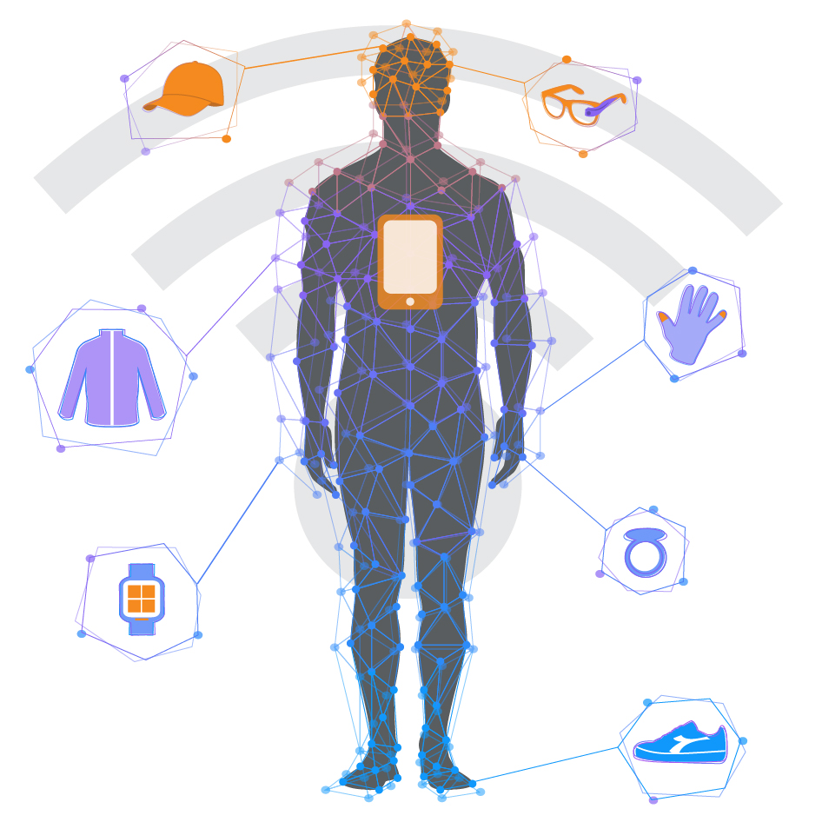
The Body Dashboard -Body Analytics &Healthcare
Haritha Ballapalli
Ravi Ranjan Prasad Karn
Vignesh Shankar

Slide 2
Aim
“The Body Dashboard- Body Analytics and Healthcare “ project is to build a system which gathers medical and physiological data of a person and analyze various health outcomes of that person using IBM Watson and Machine Learning Algorithms.

Slide 3
Architecture
Source
Medical Records
Activity Tracker data
Data Preparation
Acquire data
Cleanse
Deploy
IBM Watson
Validate
End users
App Users

Slide 4
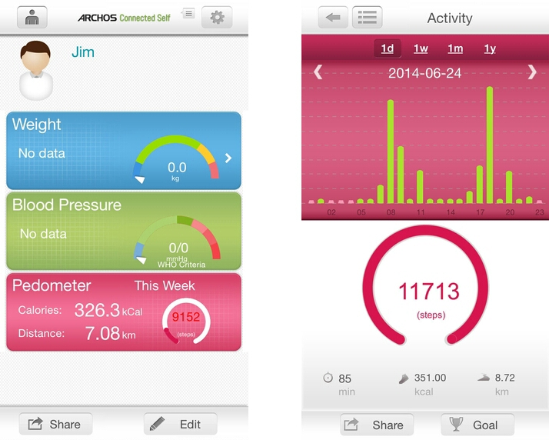
Input Data
- Medical records
- Activity Tracker Data

Slide 5
Data processing
Machine Learning Algorithms
Cognitive Computing Platform-IBM Watson

Slide 6
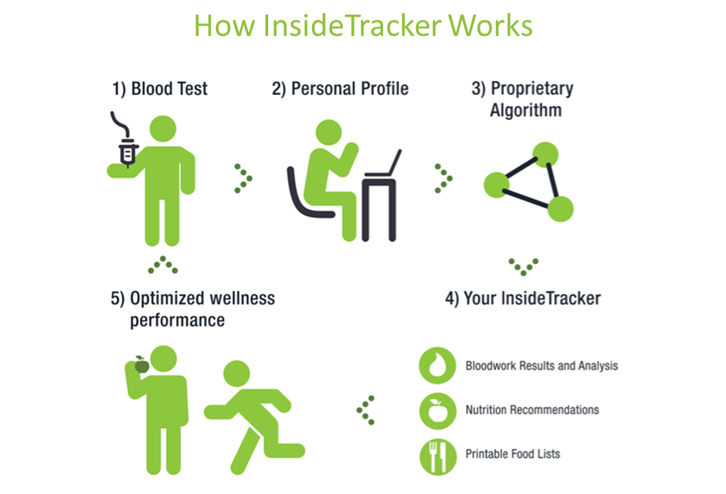

Slide 7
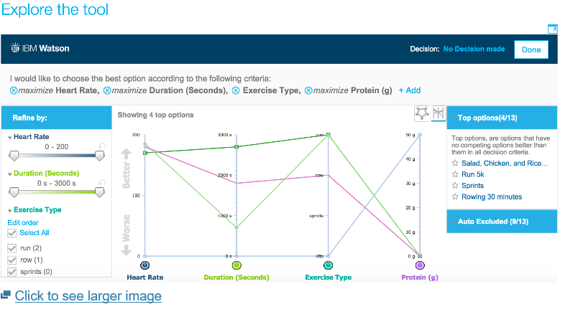
Sample Output

Slide 8
Technology used
R
Python
HDFS
Watson API
HTML
Java Script

Slide 9
References
IBM Watson Ecosystem.
Fitbit Charge HR review: a heart rate tracker that skipped a beat.
Advancing the science of measurement of diagnostic errors in healthcare : the safer Dx framework by Hardeep Singh and Dean F. Sitting in BMJ Quality and Safety, issue 24, no. 2.
Interactive Intervention Analysis by David Gotz and Krist Wongsuphasawat.
Quantified Self-Movement.

